Slide 2
Reference link
https://docs.djangoproject.com/en/3.0/intro/tutorial04/

Slide 3
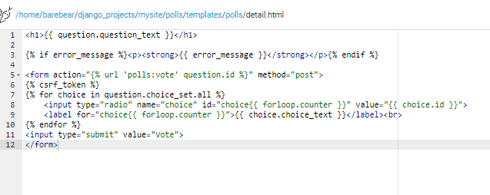
Create details.html and include HTML<form>
Under polls/templates/polls/detail.html

Slide 4
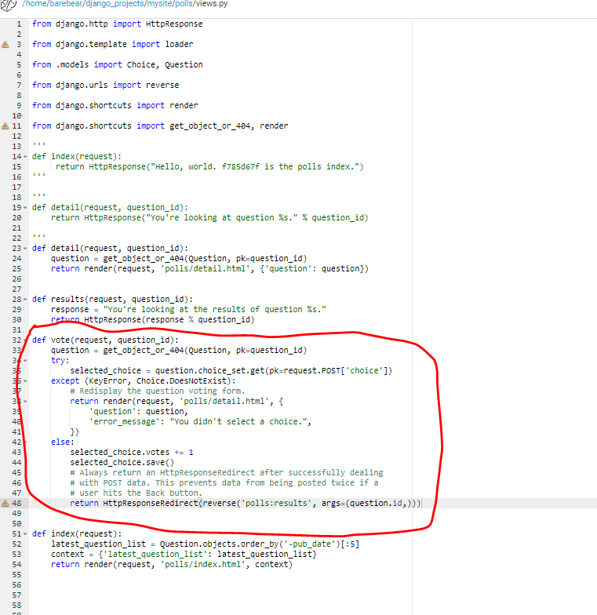
Update polls/views/py

Slide 5
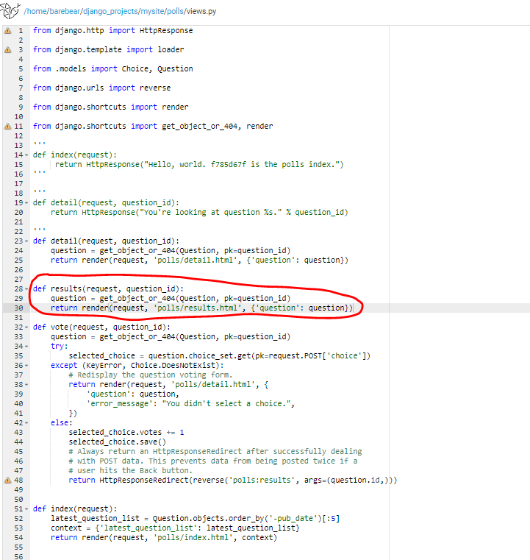
Update polls/resulst.py

Slide 6
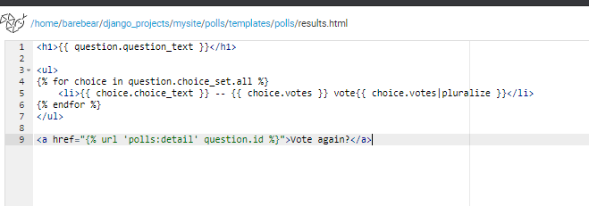
Update polls/templates/polls/results.html

